Slide 1
Ggplot2 & Plotly
Notes:
dkgifgh

Slide 2
Agenda
Recap and Optional Reading on UI’s
How to turn in Homework Assignments
ggplot2
plotly
Practice

Slide 3
User Interface Documentation
Application layout guide: https://shiny.rstudio.com/articles/layout-guide.html
Tabsets: https://shiny.rstudio.com/articles/tabsets.html

Slide 4
Turning in Homework

Slide 5
Email Content
Send emails to: gla@andrew.cmu.edu
Your Name
A link to your online GitHub Repo
Technically due at 12:00AM Saturday

Slide 6
First Homework Assignment
Creating a basic UI is necessary to understanding how to organize shiny applications for users. Students are expected to choose one of the layouts discussed during the first week of class and create a basic layout using one of the generic datasets provided in some R packages (mtcars, diamonds, starwars, etc).
The UI should have two (2) input elements and one (2) plots and/or data table. The input elements do not have to interact with the plots or data tables for this assignment, they simply must be present in the UI.

Slide 7
ggplot2
https://ggplot2.tidyverse.org/

Slide 8
What is ggplot2?
Ggplot2 is the premiere visualization package for R
Created by Hadley Wickham, Winston Chang, Kara Woo, Thomas Lin Pedersen, Claus Wilke and Kohske Takahashi
It can create just about any chart you can conceive of.

Slide 9
Setting up a plot
ggplot()
Arguments:
data: Dataframe/tibble you’re visualizing
aes(): place the following arguments inside here for grouping, outside for the same thing
x: column for X coordinate
y: column for y coordinate
group: column to group information by
color/fill: color or column to group colors by
shape: shape or column to group shapes by
alpha: opacity or column to set opacity

Slide 10
Chart Types today
Bar charts – geom_bar()
Scatter plots – geom_point()
Correlation – geom_smooth()
Histogram/Density – geom_histogram()/geom_density
Boxplot/violin plot – geom_box()/geom_violin()
Time series - geom_line()

Slide 11
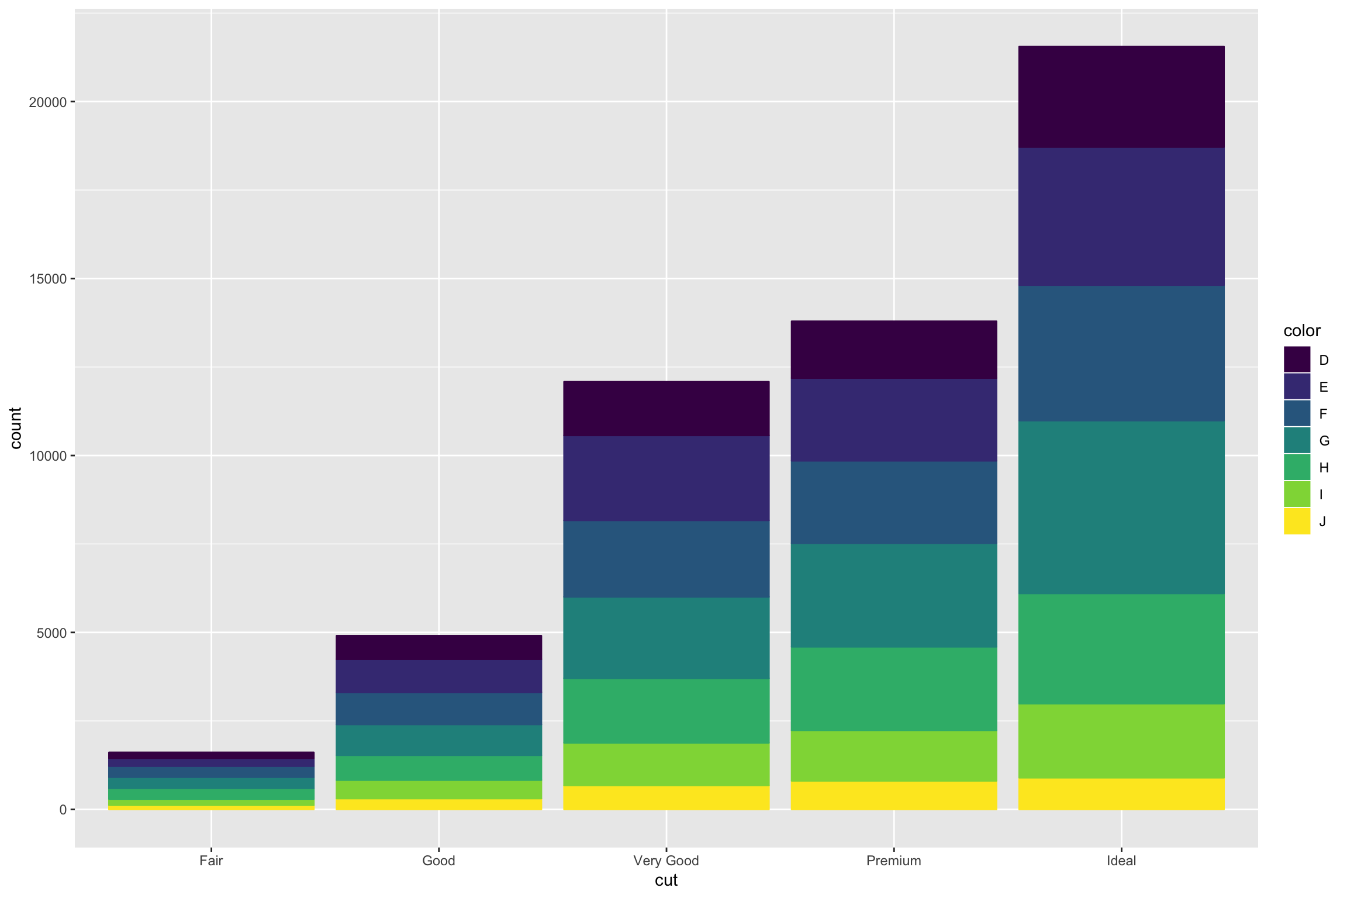
Bar chart

Slide 12
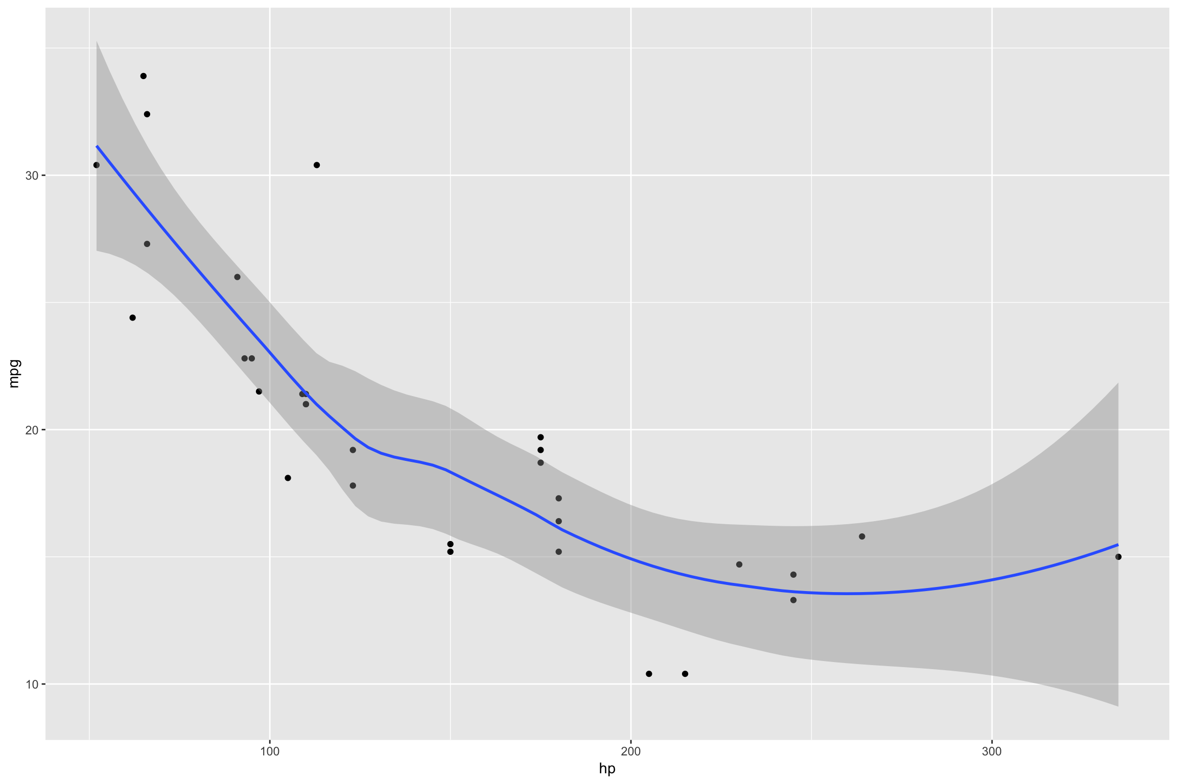
Scatter Plot

Slide 13
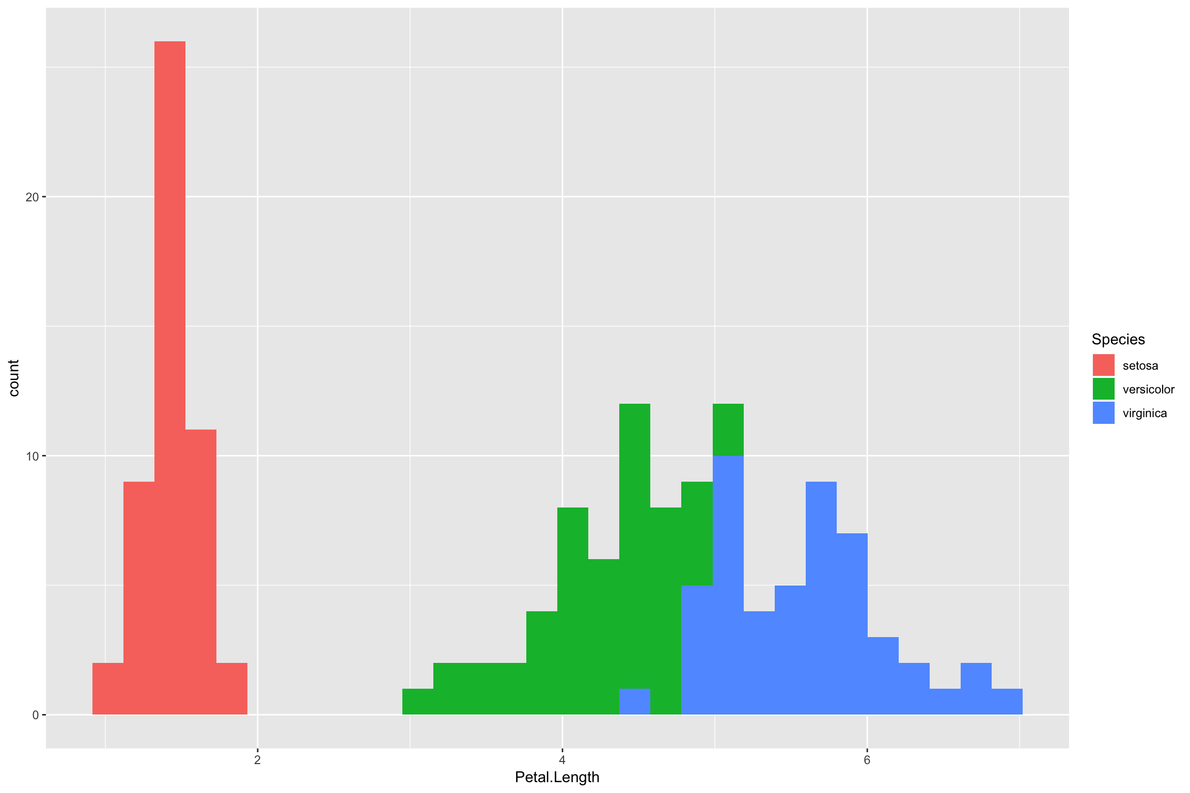
Histogram

Slide 14
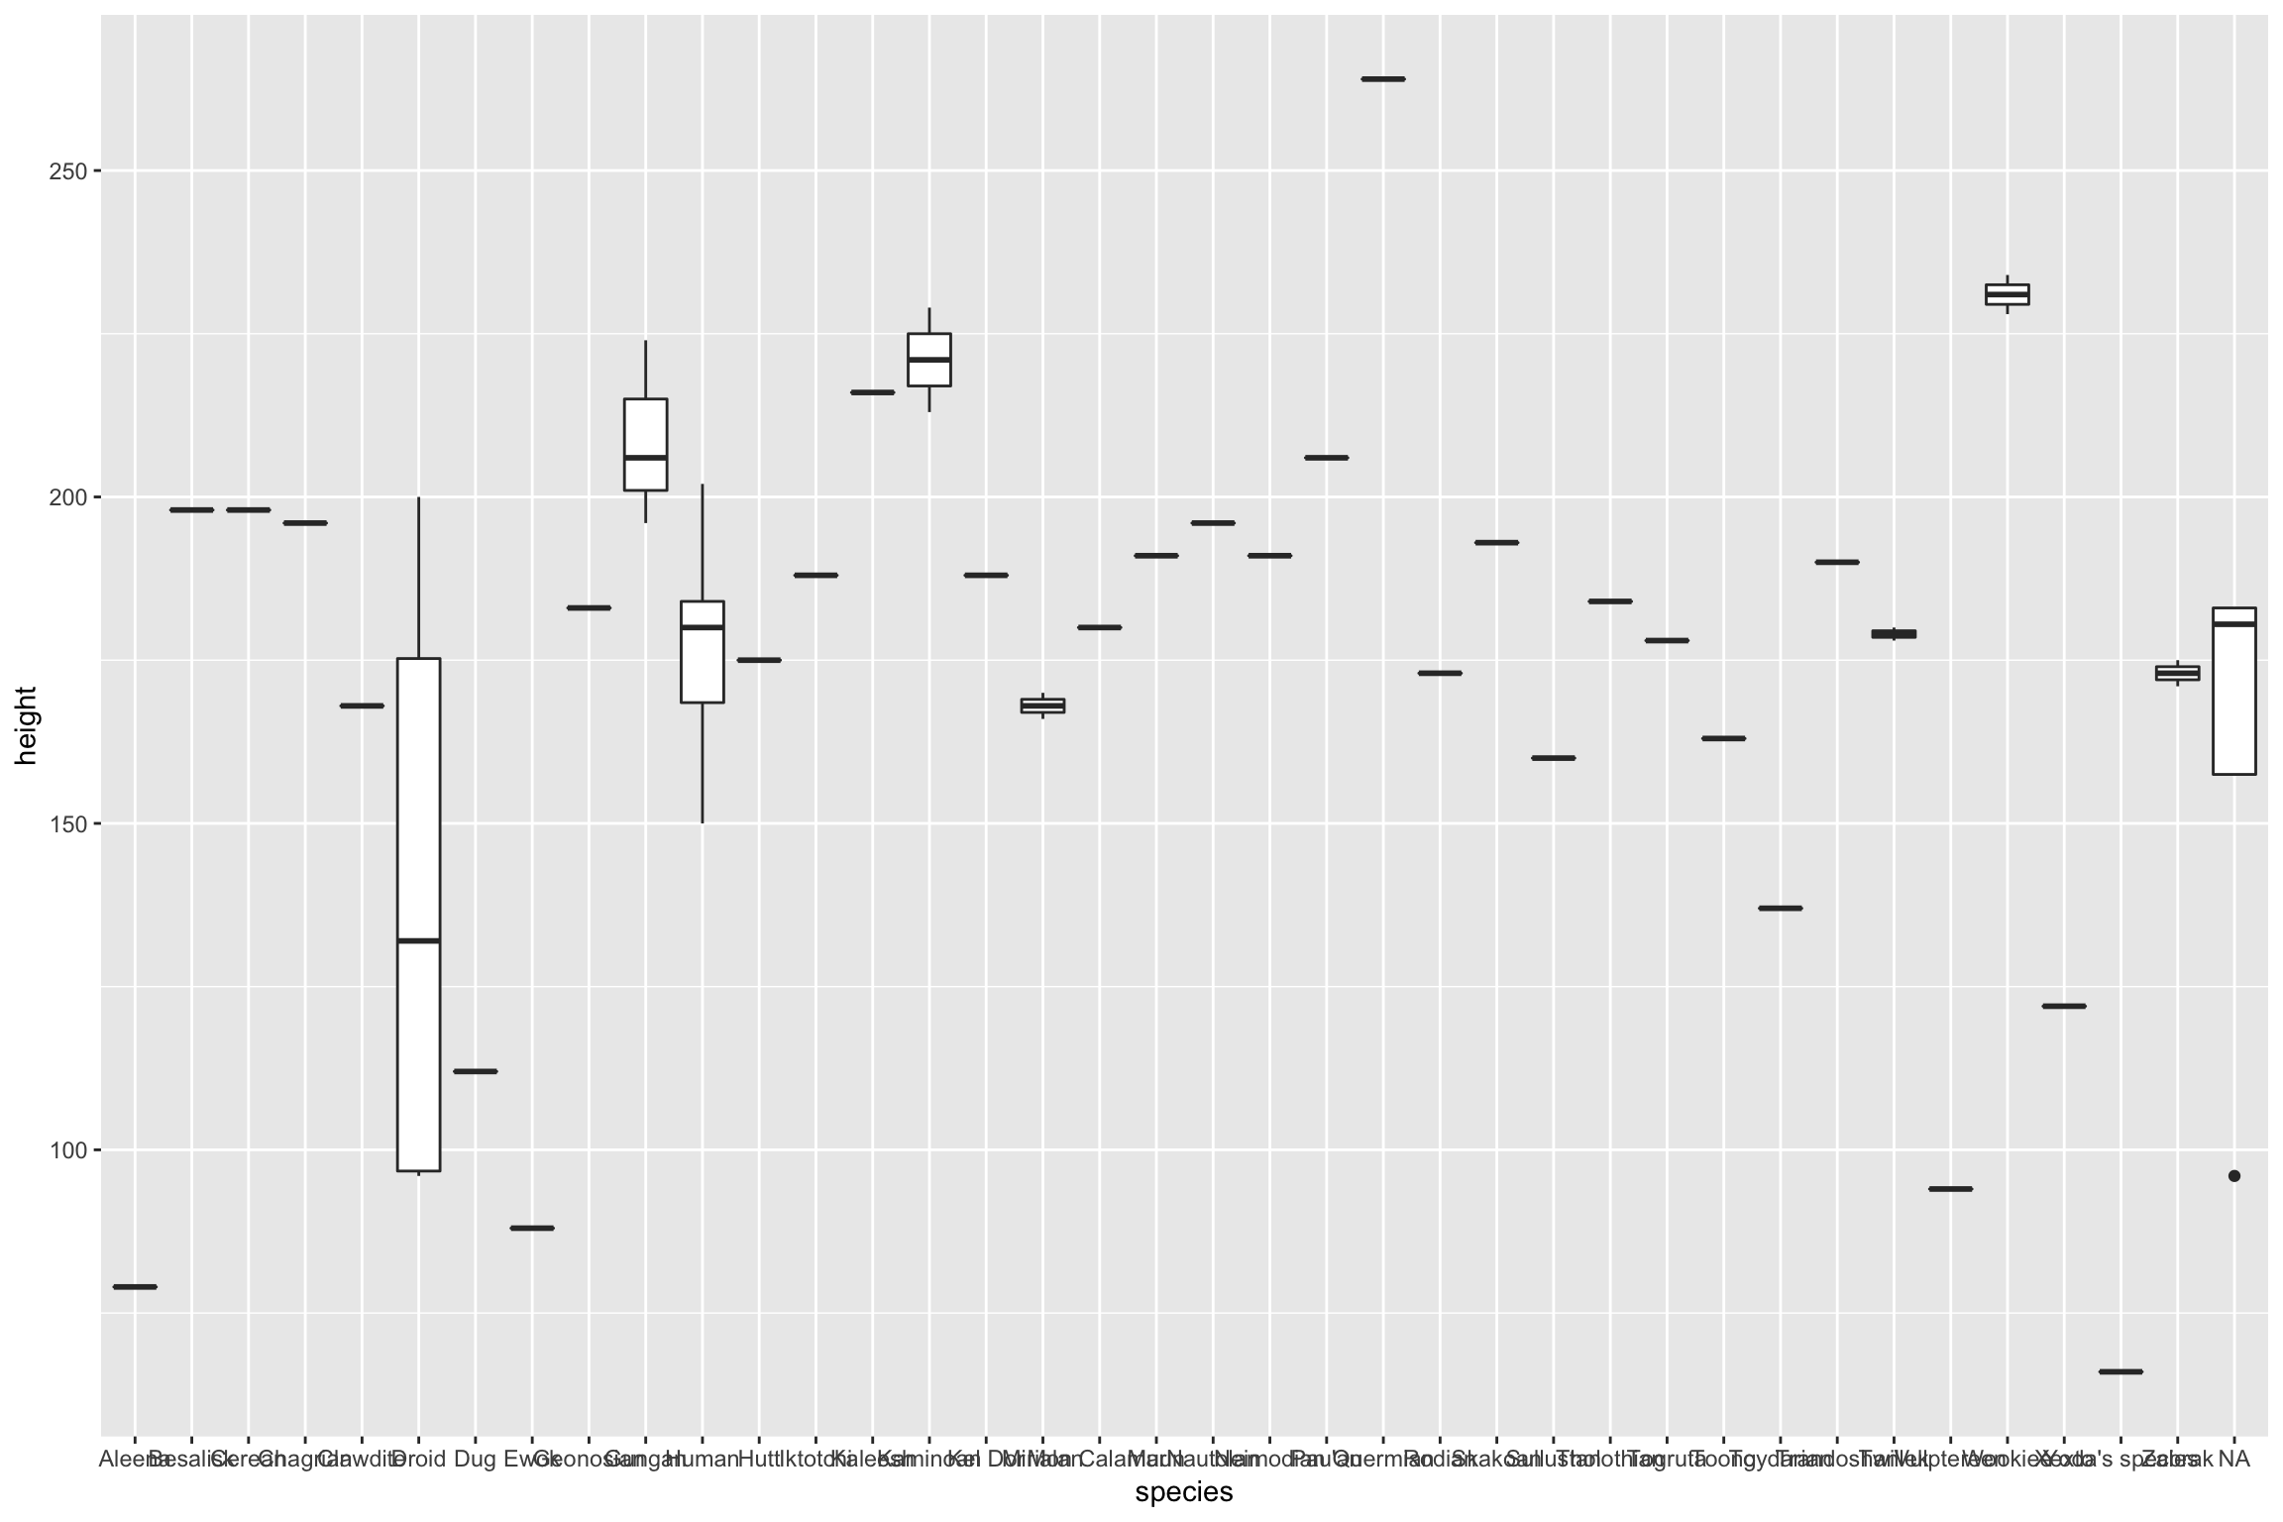
Boxplot

Slide 15
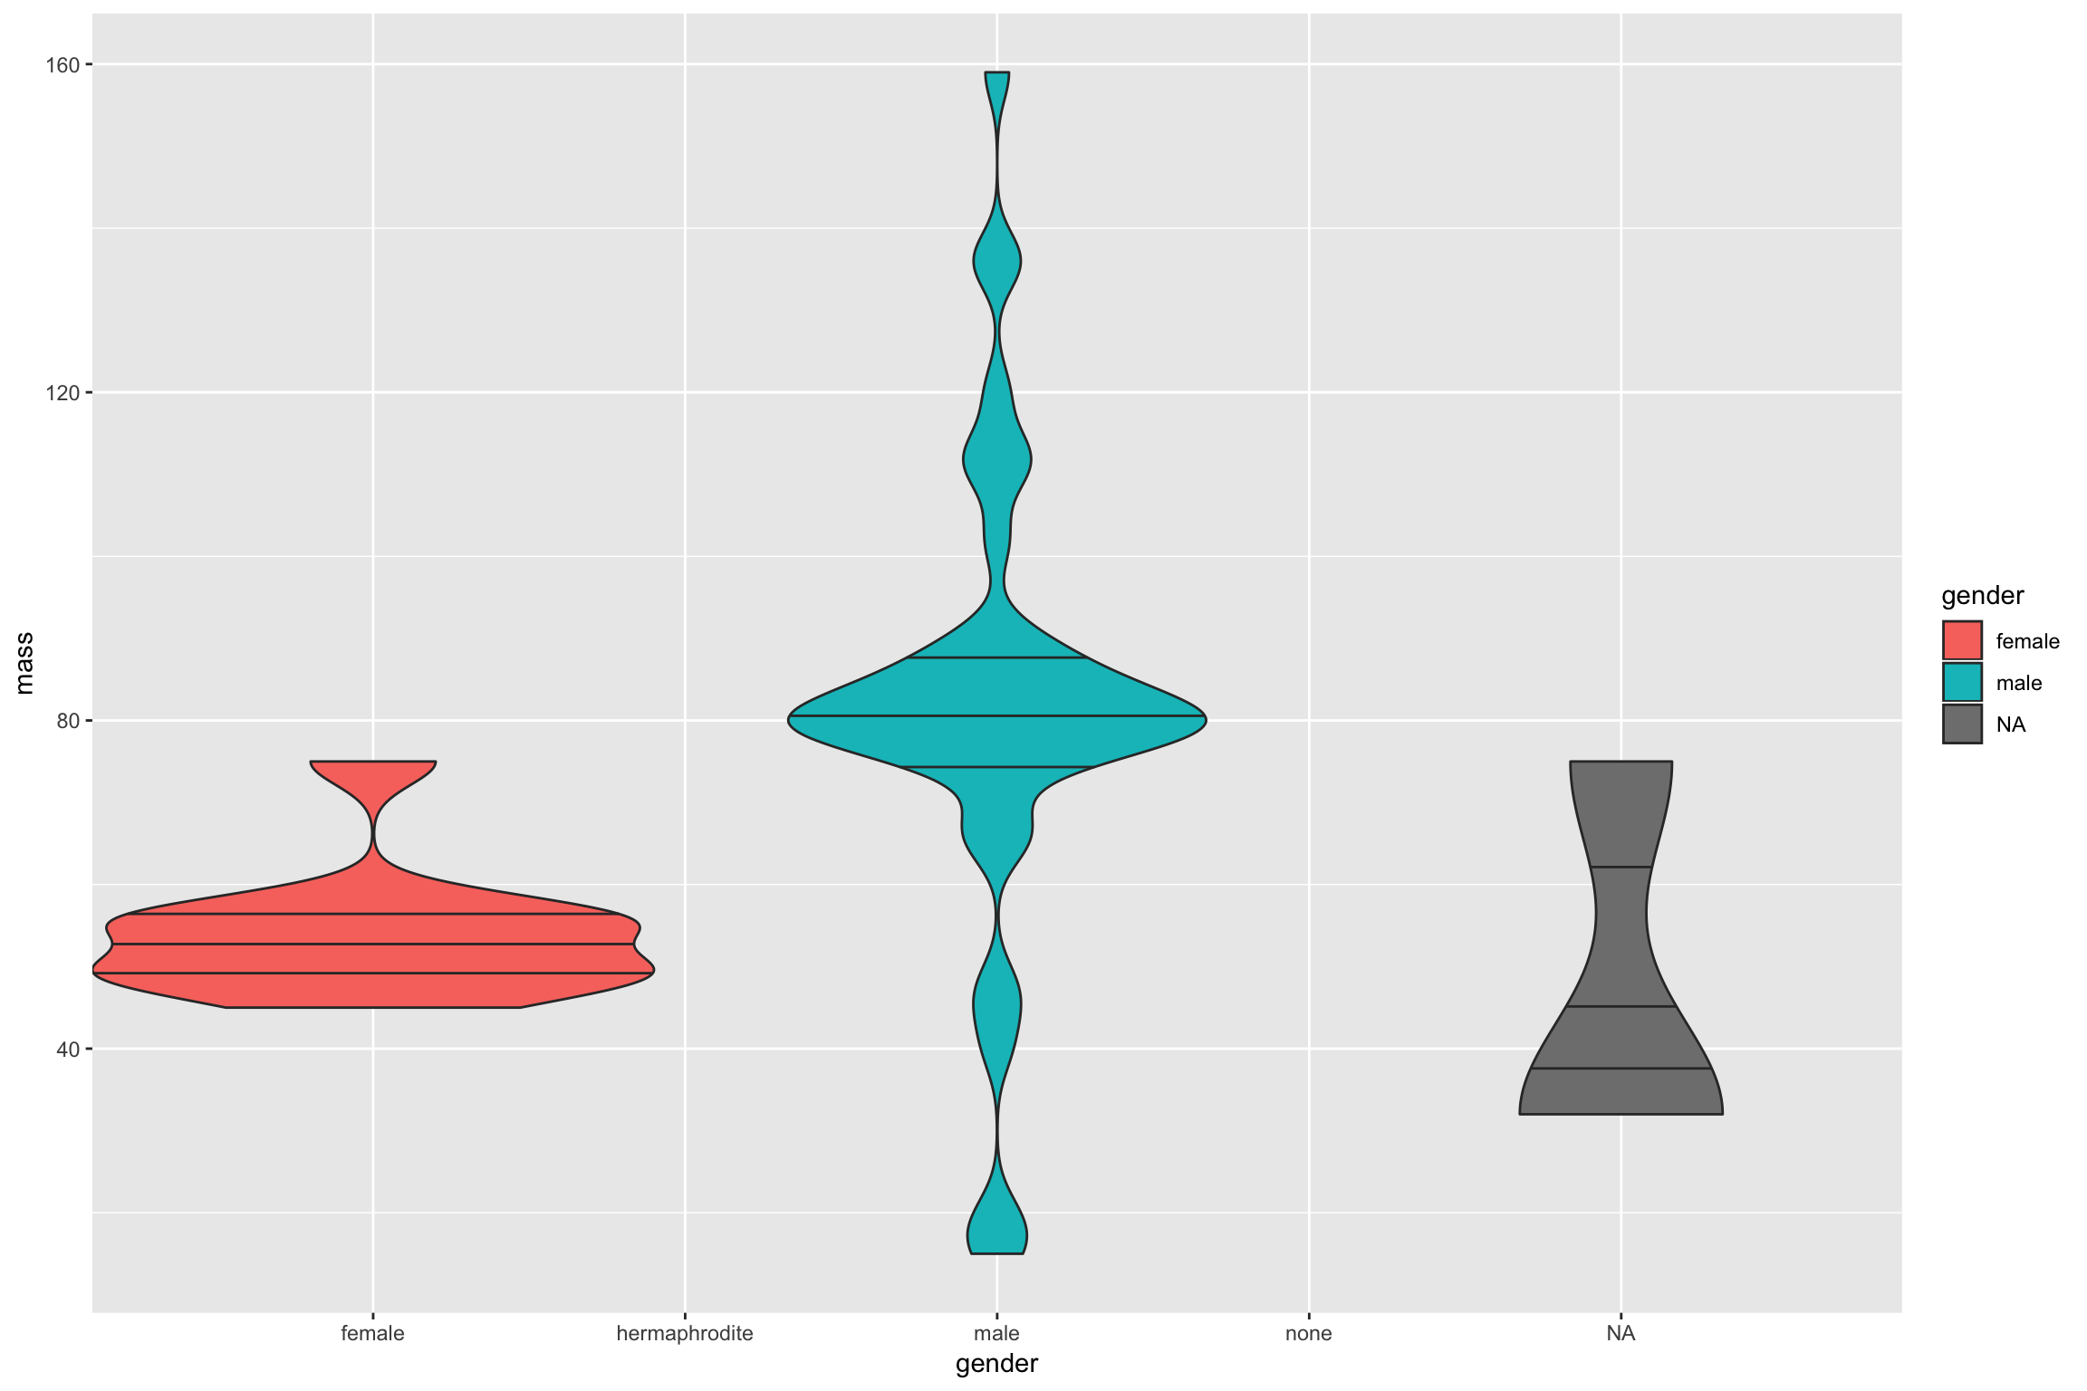
Violin

Slide 16
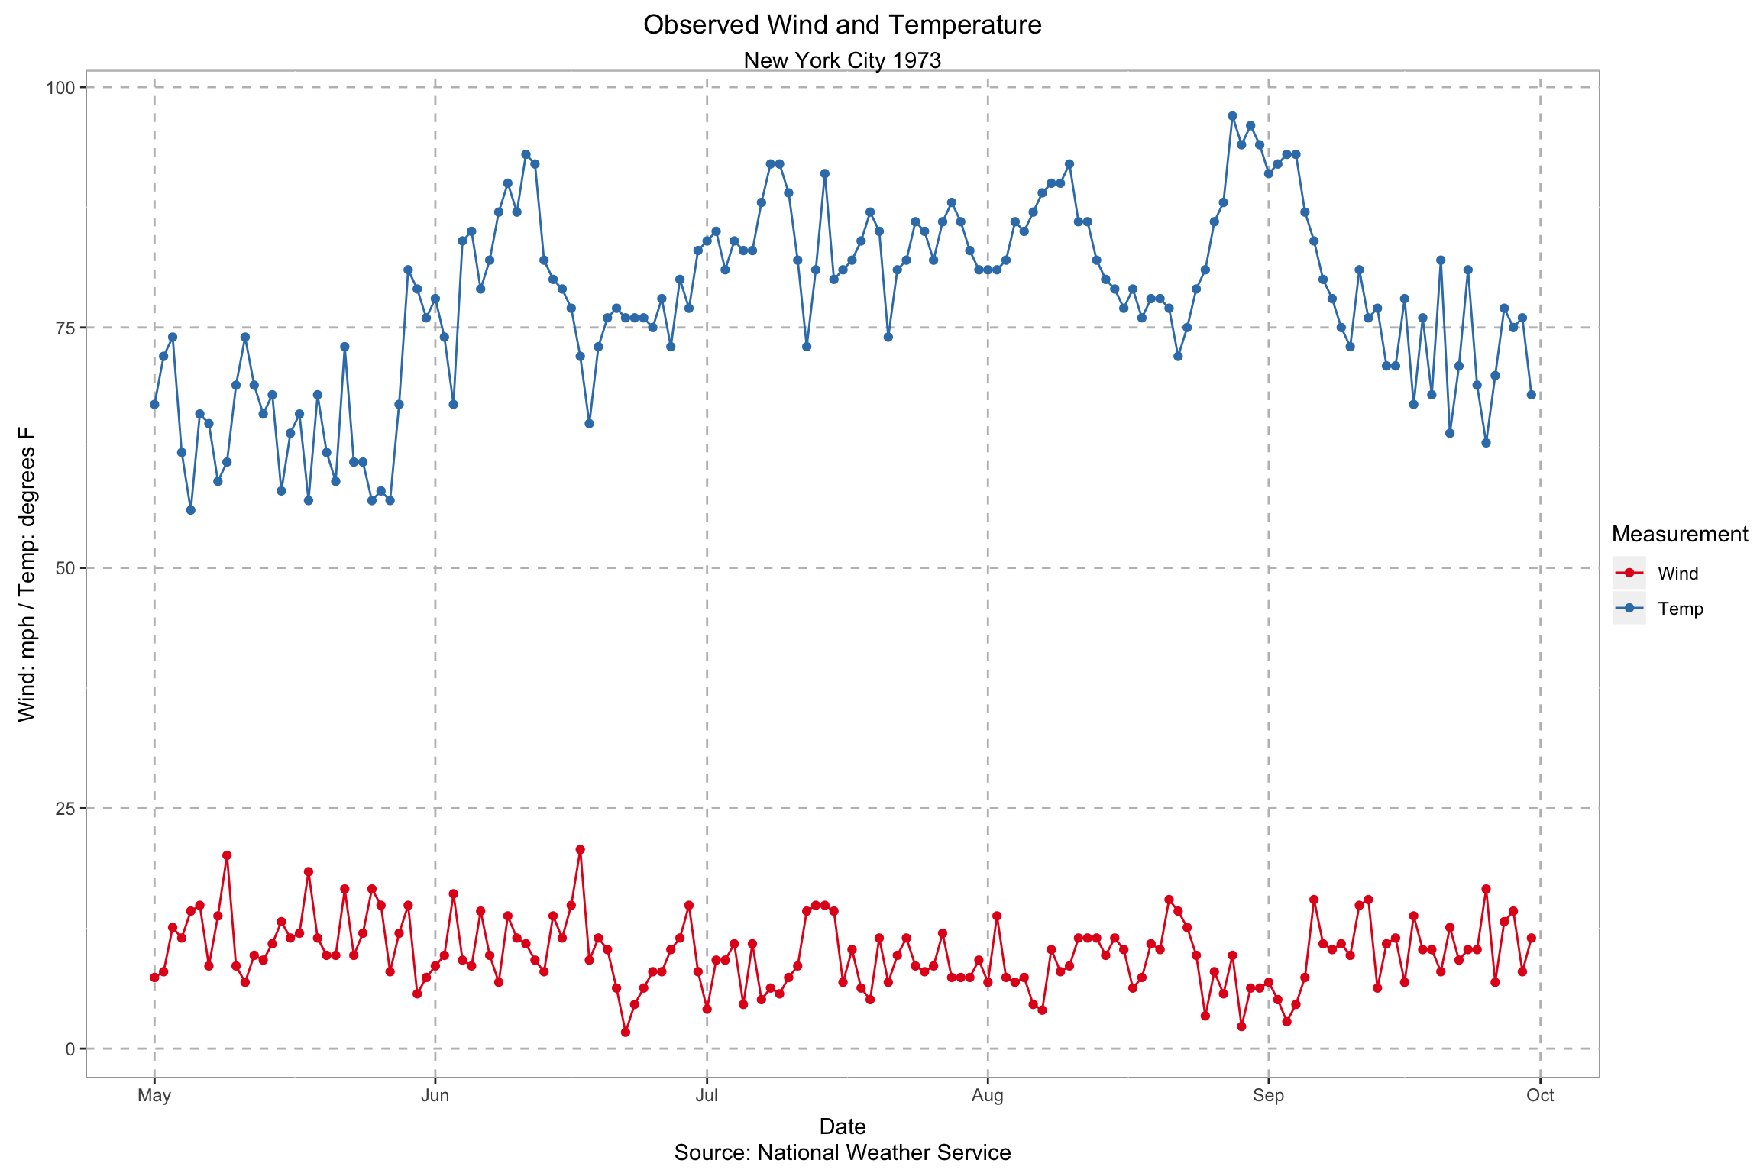
Time Series

Slide 17
Other ggplot concepts
Axis and Guides Labels
Colors
Themes
Facet wrapping
Add single lines: geom_hline()/geom_vline()
Adding labels: geom_text()

Slide 18
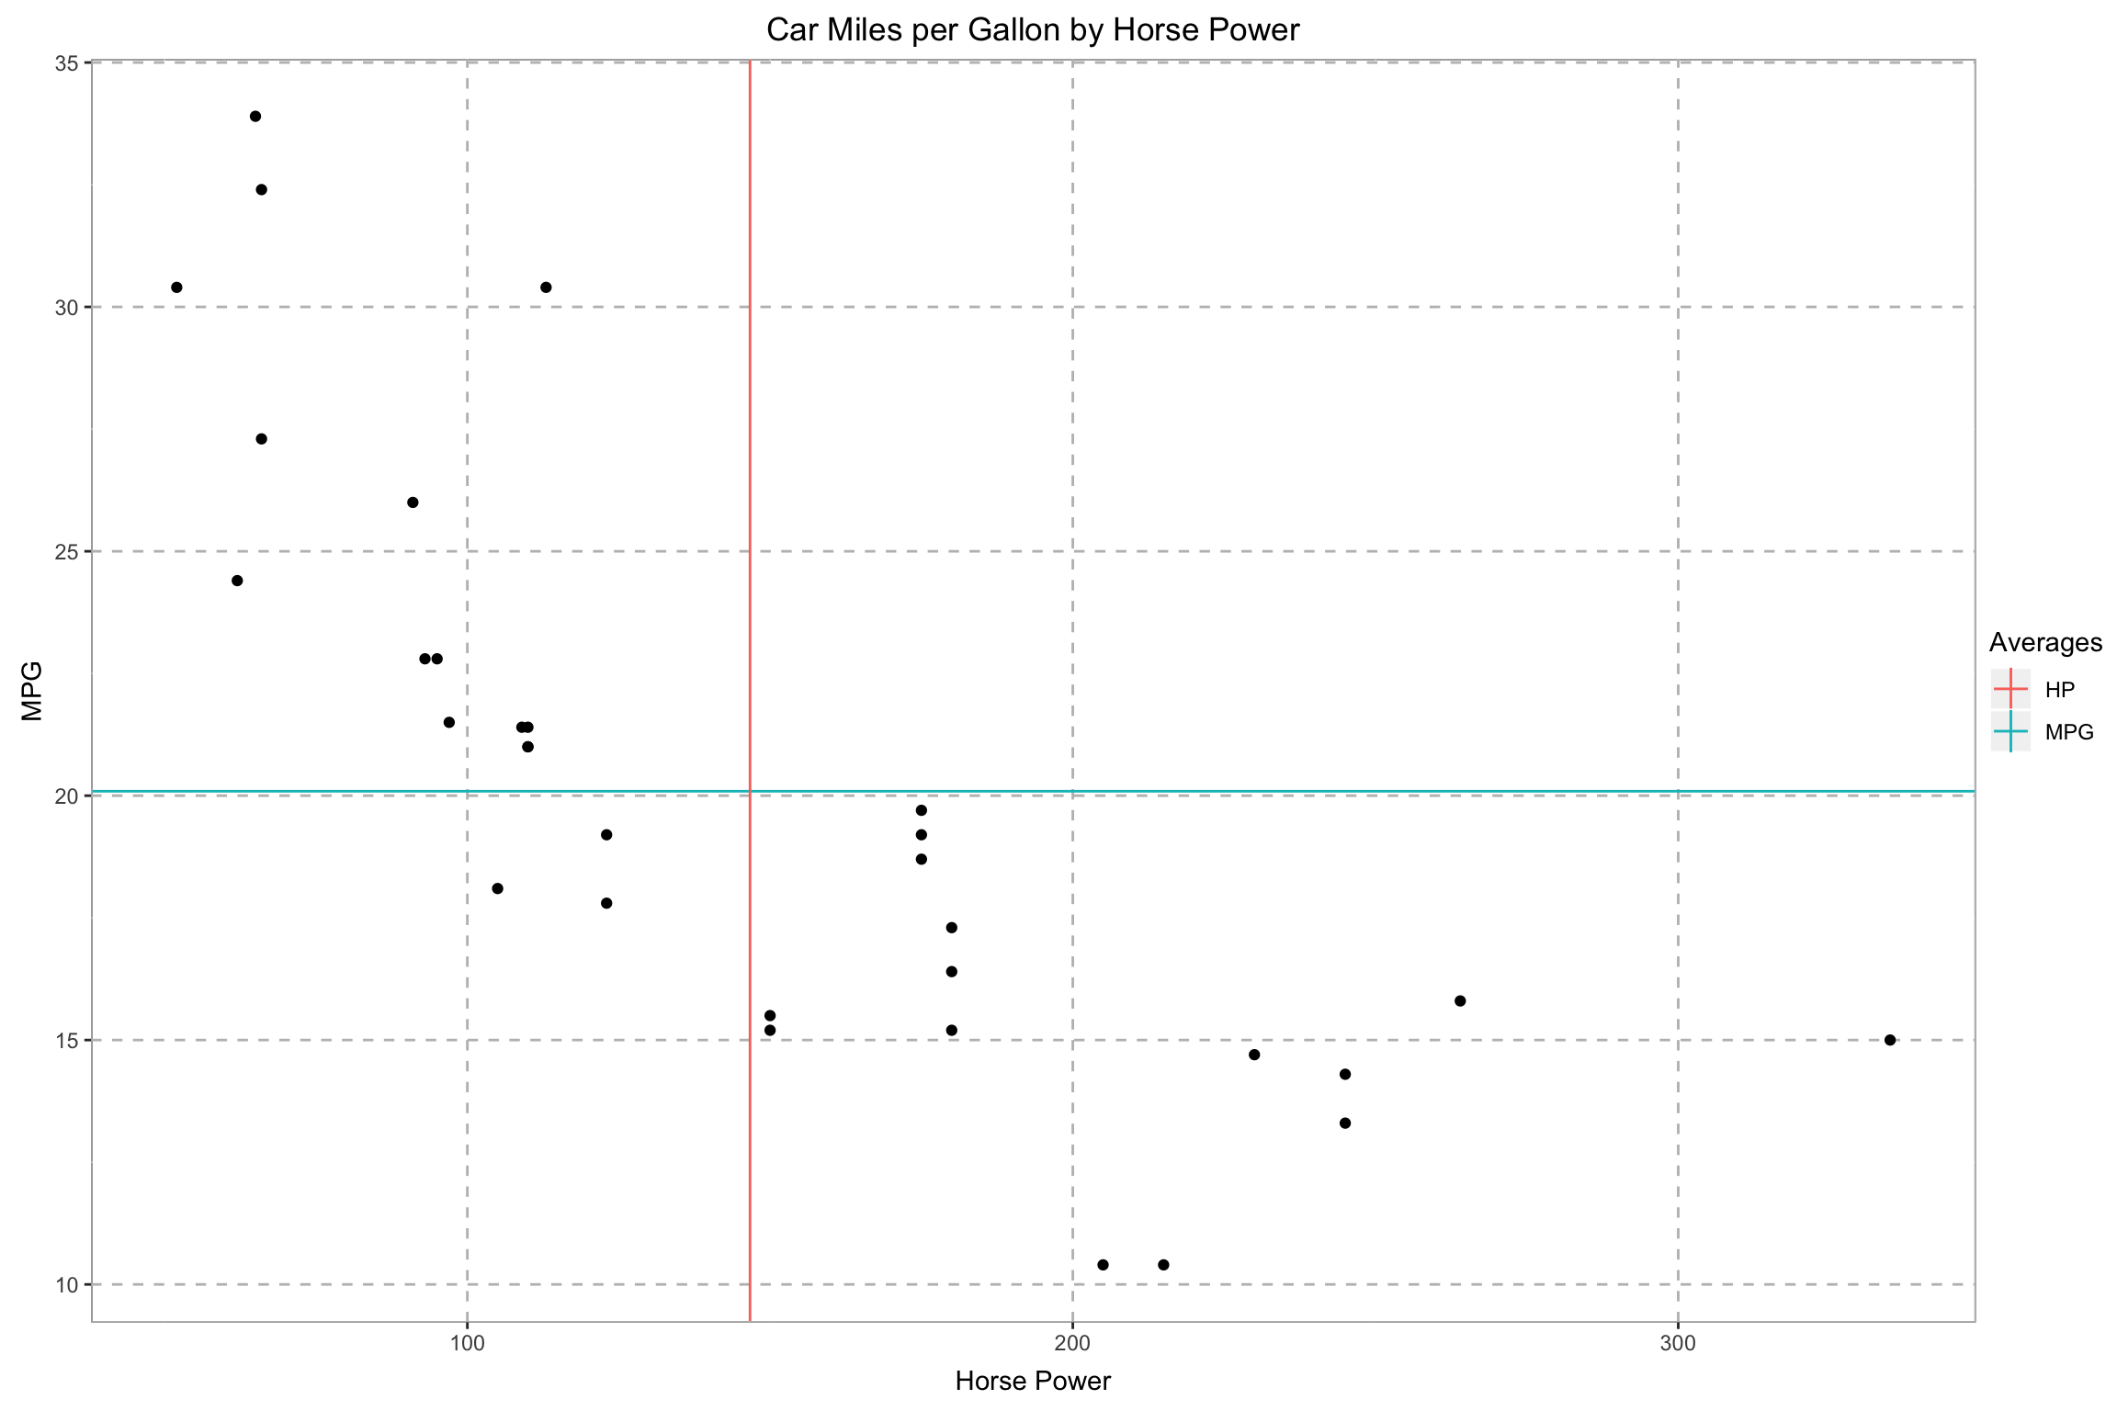
Lines

Slide 19
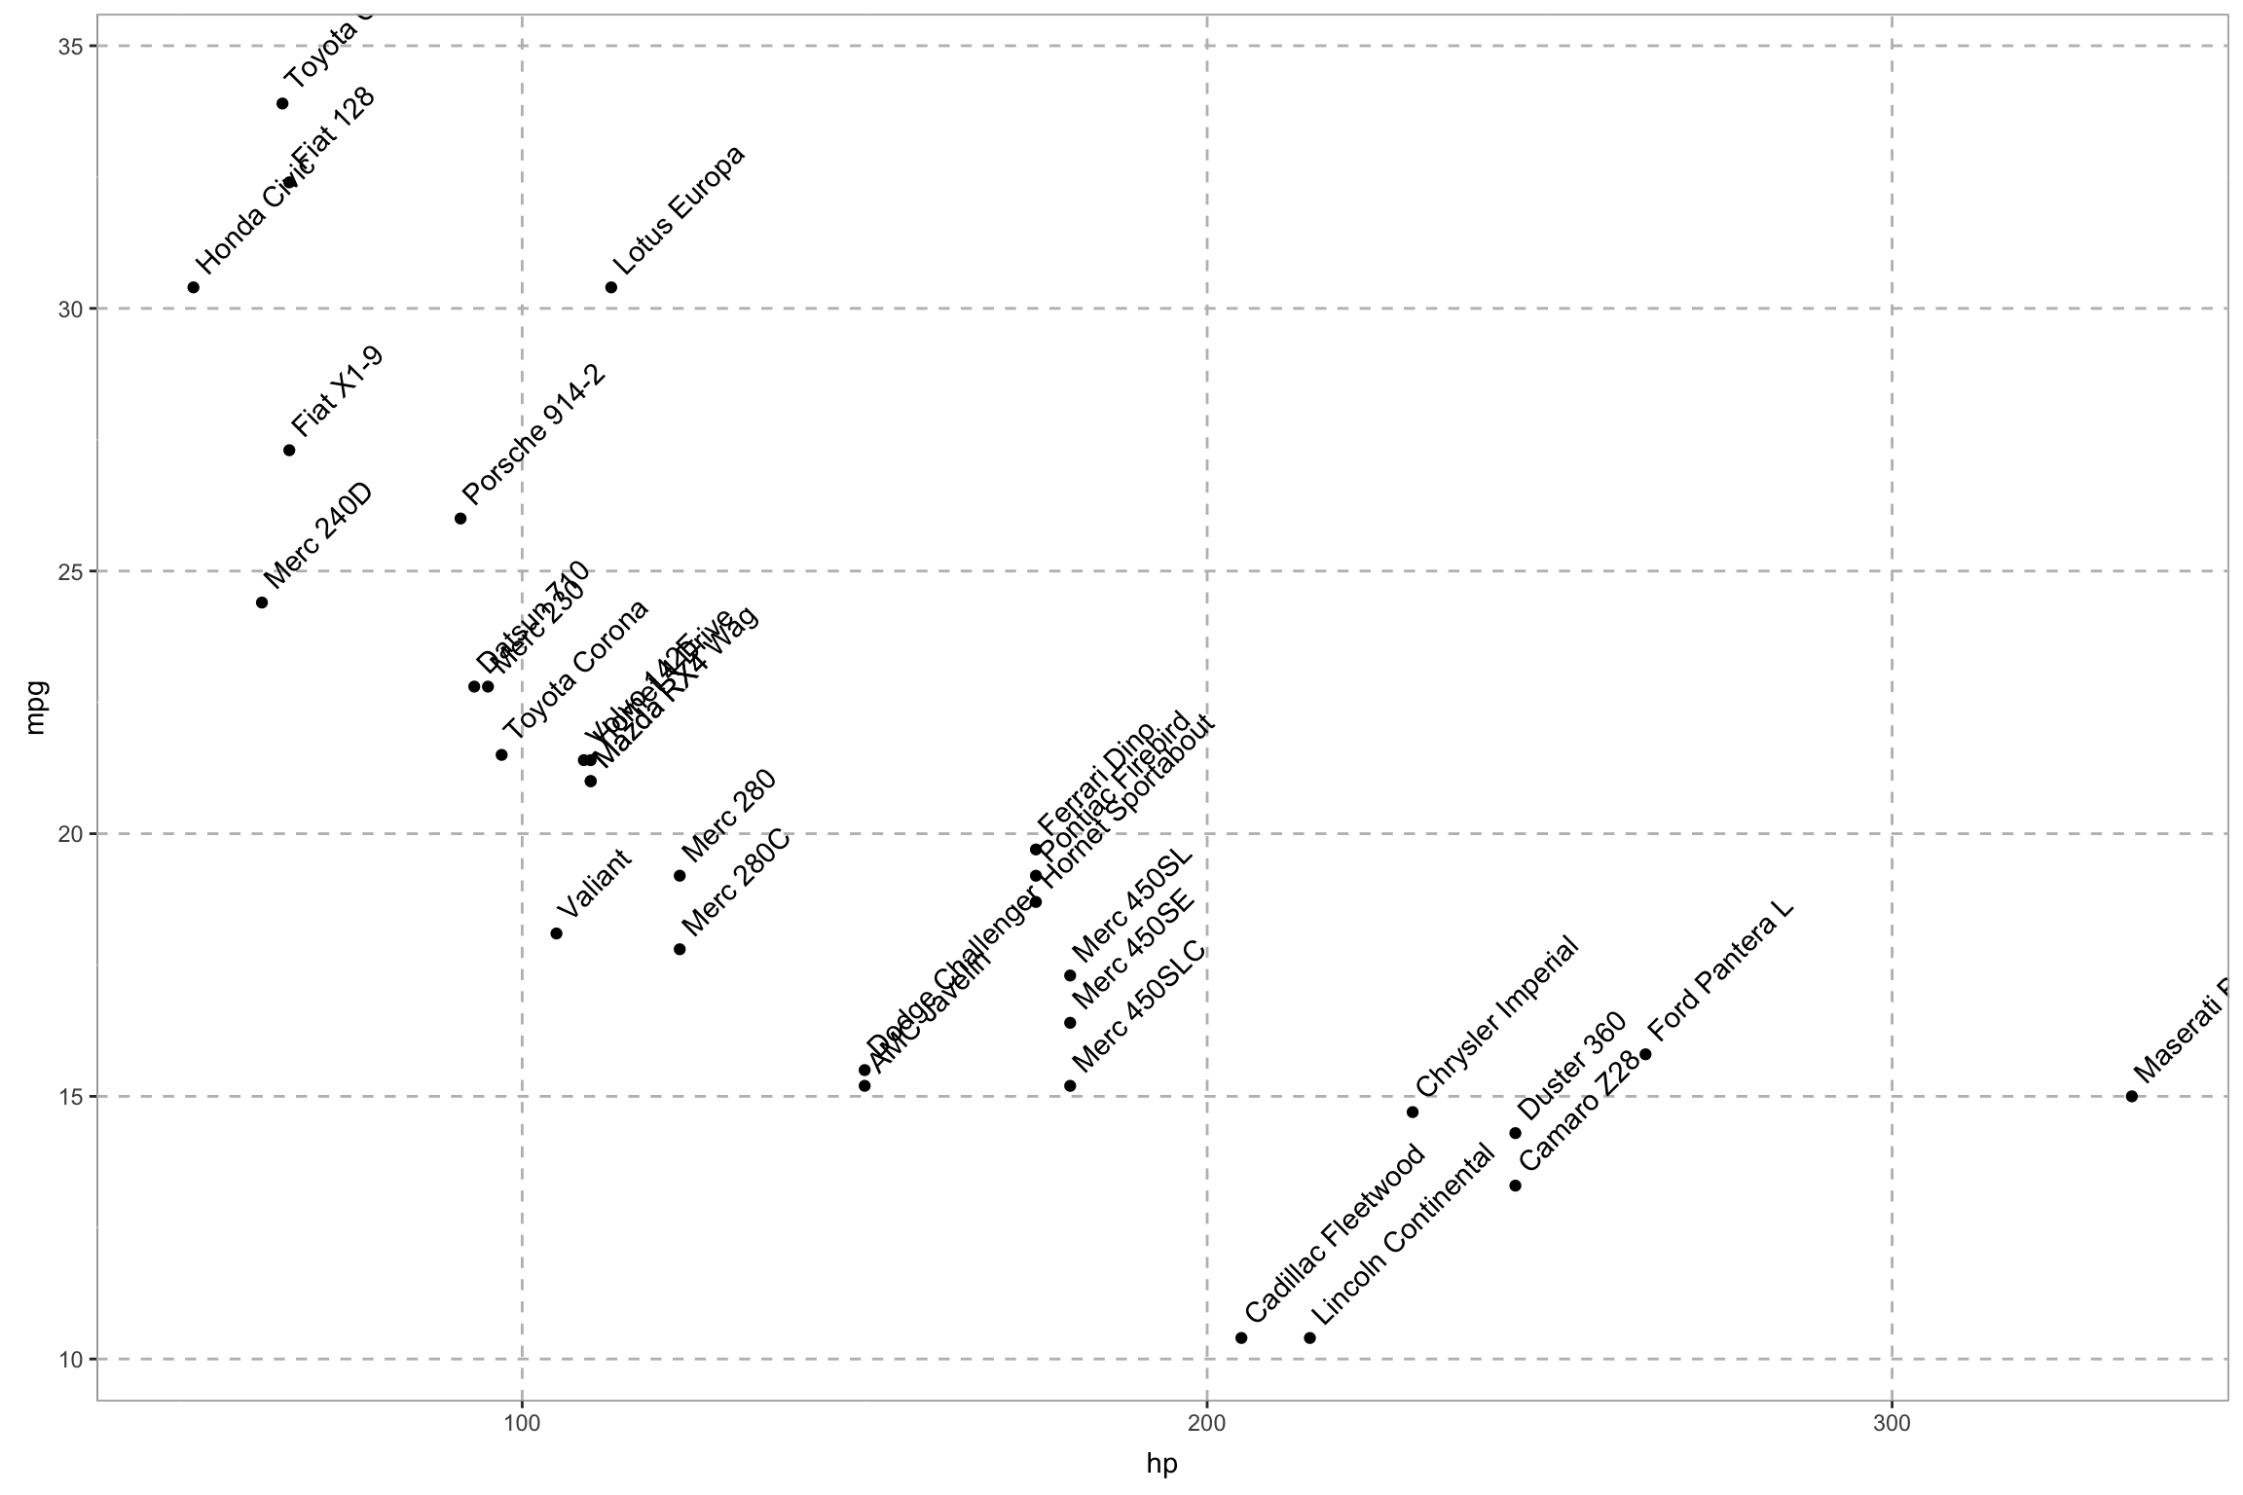
Labels

Slide 20
http://colorbrewer2.org/

Slide 21
plotly
https://plot.ly/r/

Slide 22
Wrap it
ggplotly(
# Your ggplot2 code here!
)

Slide 23
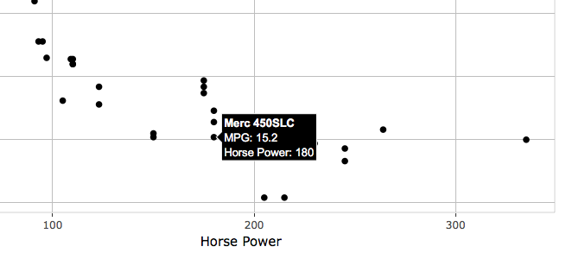
Custom tooltip
ggplotly(
ggplot(mtcars, aes(x = hp, y = mpg, text = paste("<b>”, rowname, "</b><br>",
"MPG:", mpg, "<br>Horse Power:", hp))) +
geom_point() +
ggtitle("Car Miles per Gallon by Horse Power") +
xlab("Horse Power") +
ylab("MPG"),
tooltip = "text"
)

